Slide 1
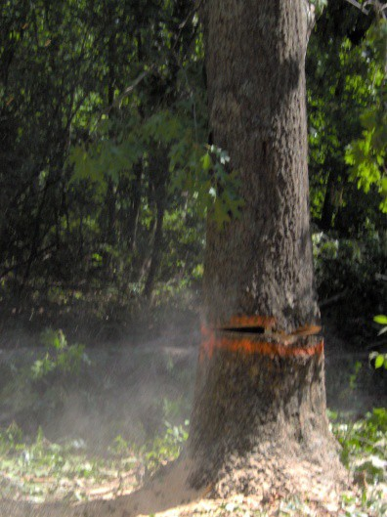
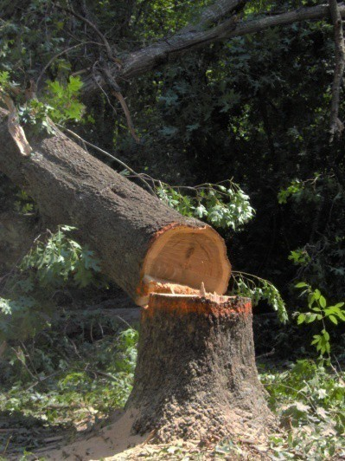
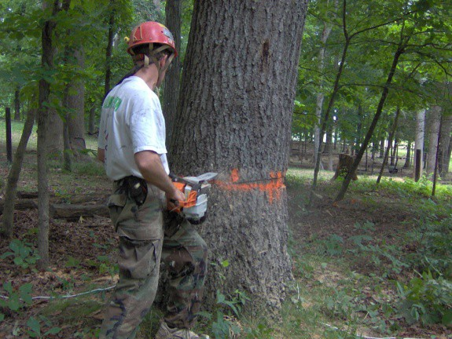
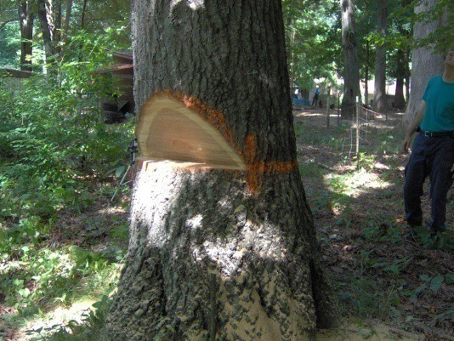
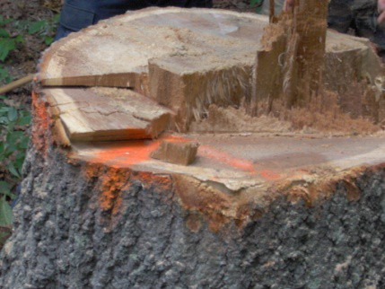
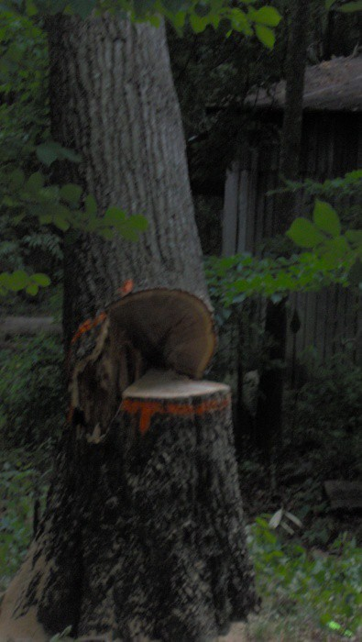
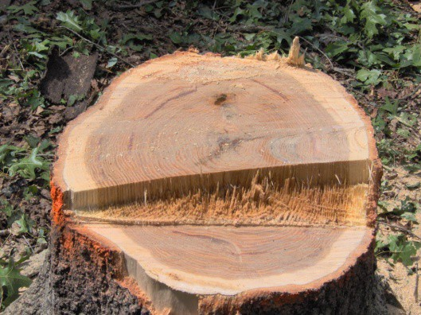
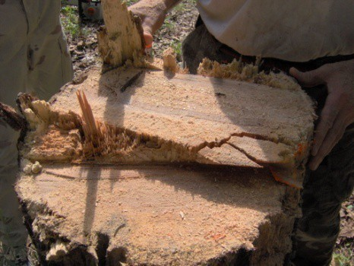
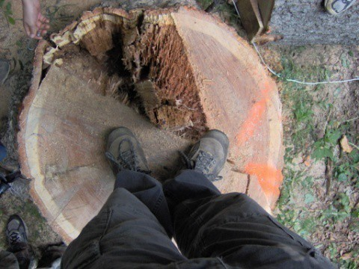
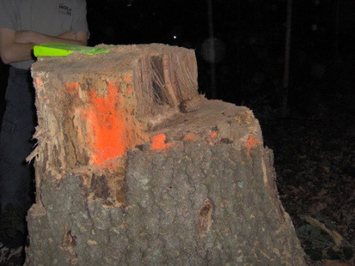
The Craft of Tree Felling
Alan Hale
June 2024

Slide 2
Outline
Felling in the Direction of Slight Lean
Facing Issues Felling Difficult Trees

Slide 3
Sizeup
Search for overhead hazards
Debris
falling from above causes over one-half of all felling accidents
Practice watching overhead while cutting
Occasionally glance at the saw, kerf, and top of the tree
Check for snags (standing dead or dying tree)
Snags may fall at any time due to wind or vibration from a felled tree
Cut any snags in the felling area first
Swamp out the base
Remove all material that could cause sawyers to lose their balance
Many fatalities have occurred because the
sawyer could not move
far enough away from the stump
to avoid being struck or pinned
Assess the tree’s lean
The tree has two natural leans: head lean and side lean
Project a vertical line from the center of the tree’s stump
Use two different locations at right angles to each other
Check for soundness of the holding wood
Bore a hole with a cordless electric drill or the chain saw
Evaluate the wood quality from:
Color of the sawdust and
Ease of penetration

Slide 4
Felling In The Direction Of Slight Lean
( Conventional Face Cut )
2
Stump Shot 2-5 Inches
Holding Wood
Felling Direction
Back Cuts 3
Face Cuts
1 2
3
Lean Direction
Kerf
HW
1
D
10% of D
1/3 D
Execute the cuts standing or on one knee with the saw at waist level
Holding Wood or Hinge Wood (HW)
Vertically oriented wood connecting the stump to the tree

Slide 5
Felling Mechanics
Width Hinging
Sloping Cut
Back Cut
45º
Facing
Height Stump Shot
Holding Wood
Horizontal or Gunning Cut
Anti-Kickback Device
D
Height of holding wood -- stump shot or anti-kickback device
–
–
Prevents kickback from tree rotating about its center of mass Prevents kickback when striking another tree in standing timber
•
Width of holding wood – tree hinged to the stump while falling
–
–
Controls the direction and fall of the tree
Without holding wood the tree is unguided during the fall
•
Holding wood severed when the two face cuts meet
Face should not close until the tree
Fully committed to the fall
Falling in the desired direction
–
Improper facing (face cut too shallow, etc.)
•
•
Holding wood breaks early (unguided fall) Loss of tree placement control

Slide 6
Significance of Stump Shot
View One of Five
Back Cut & Gunning Cut On Different Plane
Back Cut & Gunning Cut On Same Plane
HW
HW
Stump Shot
Back & Gunning Cut in Same Plane

Slide 7
Significance of Stump Shot
View Two of Five
HW
HW
Stump Shot
Back & Gunning Cut in Same Plane

Slide 8
Significance of Stump Shot
View Three of Five
Felling Tree Strikes Another Tree
Felling Tree Strikes Another Tree
HW
HW
Stump Shot
Back & Gunning Cut in Same Plane

Slide 9
Significance of Stump Shot
View Four of Five
Pow
HW Breaks Prematurely
HW
Stump Shot
Back & Gunning Cut in Same Plane

Slide 10
Significance of Stump Shot
View Five of Five
Stump Shot Prevents Kickback Of The Felled Tree
Felled Tree May Hit Sawyer Due To Kickback
Pow
HW Breaks Prematurely
HW Breaks Appropriately When Sloping & Gunning Face Meet
HW
HW
Stump Shot
Back & Gunning Cut in Same Plane

Slide 11
Three Kinds of Faces
HW
HW
HW
D
D
D
Open Face
Conventional Face
Humboldt Face
Total Angle
Depth
Face Closure Back Cut
70º to 90º
45º
45º
1/3 of D
1/3 of D
1/3 of D
Tree Hits Ground
Middle of Fall
Middle of Fall
2-5 inches Above Face Intersection
2-5 inches Above Gunning Cut
2-5 inches Above Gunning Cut
Comments
Greatest Control Provided by Hinge Wood
Greatest Accuracy in Constructing the Face Cuts
Greatest Saving of Lumber

Slide 12
Facing The Tree
Goal
( Conventional Face Cut )
Always mark the location of holding wood before making face cuts!
D
•
•
Sloping cut
Dutchman
Sloping cut is at a 45º angle to the horizontal (goal)
End with the saw blade horizontal
•
Gunning cut
Set your dogs on the bottom-face corner of the rectangle
Make the gunning cut (dictates the direction of tree fall)
–
D
Difficult to make the gunning and sloping cut meet
Fixed
•
•
Sight down the kerf of the sloping cut Set a straight stick out of the kerf to sight
•
Check
–
–
–
– Verify that the re-cuts do not alter the felling direction
–
The sloping and gunning cuts must not overlap (Dutchman) Re-cut the sloping cut to correct misalignment
D
The face cuts must be cleaned out to prevent premature face closure
If the re-cuts will cause the face to extend too far into the tree, end the sloping cut directly
over the gunning cut (fixed)

Slide 13
Back Cut With A Slight Lean in the Felling Direction
Face Cut
Face Cut
Holding Wood
Lean and Felling Direction
Holding Wood
Back Cut
Back Cut
Wind Reduces Stability Stable Configuration
•
•
•
•
•
•
Back cuts 2-5 inches above and parallel to the gunning face cuts Remove bark around wedges to improve lifting effectiveness
A single wedge with wind can sever holding wood (rocking action) Do not drive the wedges hard (create heavy leaner)
Every 3-6 inches of back cut re-tighten the wedges (use an ax) Wedges are used (in general) to prevent the tree from sit-back due to
–
–
–
Incorrect estimate of lean Strong winds
Felling the tree in a different direction from the tree’s natural lean

Slide 14
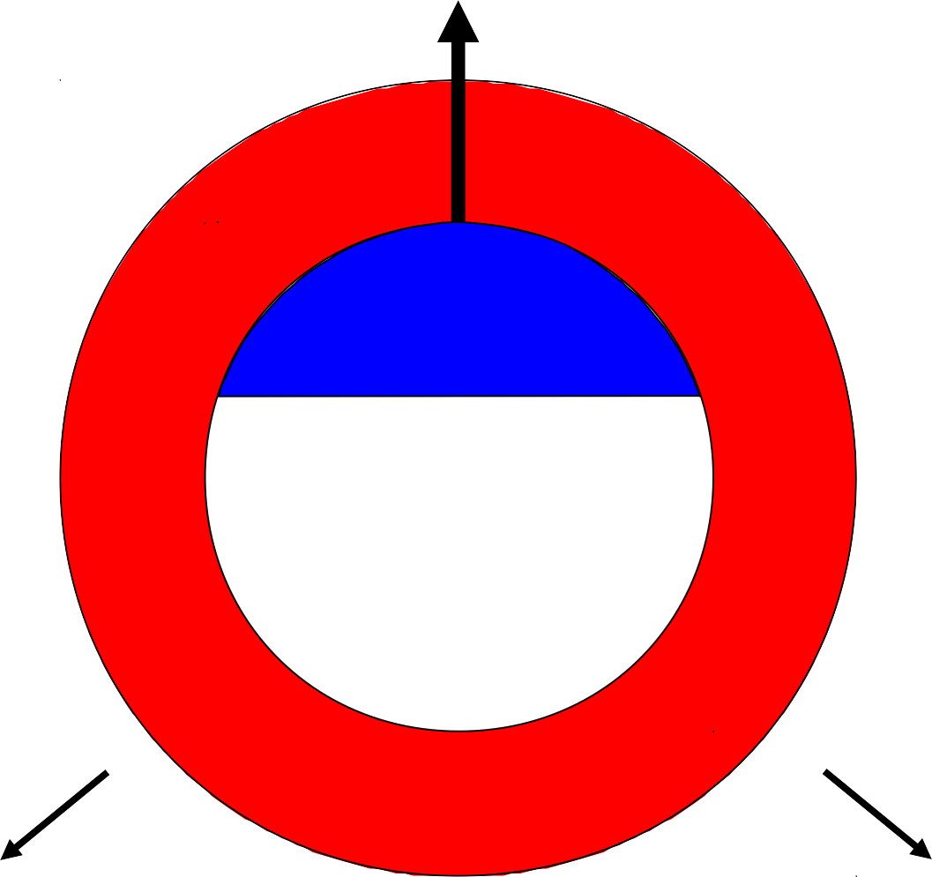
Escape Routes
Felling Direction
Escape Route
Prepare two escape routes
Minimum of 20 feet from stump
45º to the sides and back
Use large tree or rock for protection
Face Cuts
Holding Wood
Danger Zone
Danger Zone
Back Cut
Never Attempt to Escape Directly Behind the Tree
Escape Route
Escape Route
Danger Zone

Slide 15
Markup Before Cutting
Top of Sloping Cut
Small Diameter Chord
Back Cut Plane
Felling Direction
Ref Plane
1/3 D
Mark Horizontal Plane
Mark 1/3 D, Sloping, & Back Cut Plane
Mark & paint horizontal ref plane
Identify felling direction
Mark 1/3 diameter edges
Mark top of sloping cut
Paint sloping cut (optional)
Mark & paint horizontal back cut plane
Mark sloping cut
Make gunning cut
Mark holding wood (back edge)
Make back cuts
Holding Wood
(Back Edge)
Gunning Cut
Sighting Stick
Insert Sighting Stick Into Kerf

Slide 16
Felling The Tree
(Summarize)
•
•
Mark cut locations with surveyors' paint (visually plan felling approach) Face the tree (two planar cuts)
Select a face cut type: open, conventional, Humboldt
Always located on the desired felling direction side of the tree
Check face location with a horizontal line centered and perpendicular to the intersecting face cuts
Re-cut if necessary
Execute the back cut (minimum of one cut)
Most are on the same plane
2-5 inches above the face intersection cuts (establish stump shot)
Maintain holding wood (hinge wood)
Use wedges, jacks, and special back cuts to correct for lean
Watch overhead as a priority with quick glances elsewhere Escape the stump when the tree commits to the fall
Quickly follow a predetermined escape route
Do not hesitate at the stump attempting to cutting more wood
If the saw becomes stuck leave it
If the saw prevents a rapid escape drop it
•
•

Slide 17
Outline
Felling in the Direction of Slight Lean
Facing Issues Felling Difficult Trees

Slide 18
Improper Facing Issues
•
Barber-chair split
–
–
–
No face cuts (only back cut) Kerf face (saw blade thickness) Face cut < 1/3 the tree diameter
•
Felling control lost
–
–
Dutchman cut across the entire face Sloping and gunning angle too shallow
•
Felling direction altered
–
–
–
Vertically angled face cut Dutchman cut only on one side Face not cleared out on one side

Slide 19
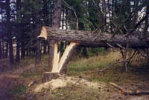
No Face Cuts (Only Back Cut)
( Improper Facing – Barber-chair Split )
Tree
Kick back
Back Cut
D
D
No Face Cuts Barber-Chair Split
The back cut progresses without facing
Eventually the tree falls faster than the back cut progress Tree will always barber-chair split
Tree kick back extremely dangerous to the sawyer
Quality of the wood greatly reduced due to the vertical split
•
•
•
•
•
Any Tree Can Be Felled Without Facing – Costly And Dangerous

Slide 20
Kerf Face (Saw Blade Thick)
( Improper Facing – Barber-chair Split )
Tree Kick back
Back Cut
Face Cut
D
D
Shallow Face Cut Barber-Chair Split
Face closes quickly
Tree falls much faster than the back cut progress Tree will always barber-chair split
Tree kick back extremely dangerous to the sawyer
Quality of the wood greatly reduced due to the vertical split
•
•
•
•
•

Slide 21
Face Cut < 1/3 The Tree Diameter
( Improper Facing – Barber-chair Split )
Actual Felling Direction
Back Cut
HW
Face Cuts
Desired Felling Direction
Back Cuts
Face Cut
Actual Felling Direction
D
Facing Cut Too Shallow
•
•
•
•
Small face opening is ineffective at directing the tree Holding wood is either broken or torn out
Loss of control early in the felling process Tree likely to barber-chair

Slide 22
Dutchman Cut Across The Entire Face
( Improper Facing – Felling Control Lost )
Barber-Chair Split
D
D
D
Sloping Face Dutchman
Gunning Face Dutchman
Result of the Dutchman
•
Dutchman definition
One of the face cuts extends beyond the other face cut
Face within a face
Dutchman tree felling mechanics
Dutchman closes
Tree splits vertically (barber-chair)
Holding wood breaks off unevenly
Felling control lost
Weak tree might snap anywhere along its length
•

Slide 23
Sloping & Gunning Angle Too Shallow
( Improper Facing – Felling Control Lost )
Actual Felling Direction
Back Cut
HW
Back Cut
Face Cuts
Desired Felling Direction
Face Cut
Actual Felling Direction
D
Facing Angle Too Small
•
•
•
•
Face closes prematurely
HW is broken or barber-chair (very similar to a Dutchman cut) Tree could jump off of the stump when HW is broken
Loss of control early in the felling process

Slide 24
Vertically Angled Face Cut
( Improper Facing – Felling Direction Altered )
Actual Felling Direction
Highest HW Breaks
Sloping Cut
Desired Felling Direction
Back Cut
Back Cuts
HW
Face Cuts
Face Cuts
Highest HW Breaks
Gunning Cut
Sloped Face Cuts
D
•
The highest part of the face closes first
–
–
Pivots the tree toward the open part of the face The highest HW breaks behind the closed faces
•
The HW behind the lower part of the face
–
–
Continues to hold
Pulls the tree to the longer HW
•
Loss of felling control

Slide 25
Dutchman Cut Only On One Side
( Improper Facing – Felling Direction Altered )
Actual Felling Direction
HW
Back Cuts
Face Cuts
Desired Felling Direction
Sloppy Face Cut (HW Lost)
HW Cut On One Side
Felling process unconstrained by the side of the tree with no HW
The HW side of the tree secures the tree to the stump
–
–
Pulls (pivots) the tree to the HW side of the tree HW is eventually broken when the face cuts close
•
•
Tree does not fall in the desired direction (loss of felling control)
Used for felling trees in a direction different from natural lean
– Concept behind swing Dutchman

Slide 26
Face Not Cleared Out On One Side
( Improper Facing – Felling Direction Altered )
Actual
Felling Direction
HW
Back Cut
Face Cuts
Back Cuts
Face Cuts
Desired Felling Direction
HW
Chainsaw Bar Too Short (Obstruction)
D
Obstructed Face
•
•
•
•
•
One side of the face closes on the obstruction The hw behind the obstruction is broken
The HW on the other side of the tree pulls the tree in that direction But tree does not fall in the desired direction (loss of felling control)
Used for felling trees in a direction different form natural lean
– Concept behind step Dutchman

Slide 27
Outline
Felling in the Direction of Slight Lean
Facing Issues Felling Difficult Trees

Slide 28
Significance of Tree Diameter
Moderate To Large Diameter Trees Small Diameter Trees
Chainsaw bar too short to reach completely across the stump
Not enough room for chainsaw bar and wedges in the kerf
Difficult to execute back cut fast enough to prevent loss of control or barber-chair
Difficult to prevent sit-back
Unwanted HW
Actual Felling Direction
Desired Felling
?
HW
Saw
HW
Direction
Natural Lean
Blade
Desired Felling Direction
Face Cuts
Natural Lean
Back Cuts
Saw
Blade
Back Cuts
Face Cuts
Chainsaw Blade Too Short
No Room For Wedges

Slide 29
Felling Difficult Trees
( Moderate to Large Diameter )
•
Head Lean Heavy
•
Opposite of Head Lean Slight
•
Opposite of Head Lean Heavy

Slide 30
Head Lean Heavy
(Side-boring)
Cleavage Line
3
D
Back Cuts
Holding Wood
5
6
Maintain Holding Wood
2
5
Felling Direction
Face Cuts
1 2
8
7
Lean Direction
7
6
8
3 4
Cleavage Line
1
4
Face the tree in the felling direction (1 & 2)
Clip outside holding wood on each side to prevent side scarring (3 & 4)
Bar is pushed straight in on both sides (5 & 6) (leave holding wood)
Continue the back cut in the opposite direction of the face (7)
Stop the back cut short of the tree falling
Remove the saw blade before the back wood is severed
•
The trigger cut (8) (made in the felling direction)
–
–
Releases the tree to fall without pinching the saw blade Allows sawyer and saw blade to readily escape the falling tree

Slide 31
Opposite of Head Lean Slight
Holding Wood
Maintain Holding Wood
Saw Blade
Lean Direction
Back Cut
Face Cuts
1 2
2
Felling Direction
3
3
1
Saw Blade
D
•
•
•
•
•
•
•
Face the tree in the felling direction (1 & 2) Start the back cut (3)
Insert two wedges when room is available
Remove bark around the wedges to improve lifting efficiency Drive wedges alternatively until they are tight
Re-tighten the wedges every 3-6 inches of back cut
Continue the process until tree tips forward (do not cut holding wood)

Slide 32
Opposite of Head Lean Heavy
Wedge 1
Holding Wood
D
Bearing Plate
Maintain Holding Wood
Lean Direction
Wedges
Face Cuts
1 2
2
Back Cut
Felling Direction
3
3
1
4
4
Hydraulic Jack and Footing
Wedge 2
Face the tree in the felling direction (1 & 2)
Start the back cut (3)
Cut the hydraulic jack footing (4) (measure down from the back cut)
Remove bark around the wedge locations to improve lifting efficiency
Insert hydraulic jack with bearing plate & two wedges for lifting stability
Raise the jack and re-tighten the wedges (every 3-6 inches of back cut)
Multiple jacks may be necessary (always use wedges for stability)
Continue the process until tree tips forward (do not cut holding wood)

Slide 33
Felling Small Diameter Trees
•
Head Lean
Divided back cut Opposite Head Lean
Back cut first Head or Back Lean
Slot through holding wood
•
•

Slide 34
Head Lean -- Small Diameter Tree
( Divided Back Cut )
1 Inch
4
Back Cuts
Holding Wood
Felling Direction
Maintain Holding Wood
Face Cuts
1 2
2
Natural Falling Direction
3
4
3
1
•
•
Face the tree in the felling direction (1 & 2) Cut half of the total back cut (3)
–
–
Watch out for saw kickback Maintain holding wood (HW)
•
Place a small wedge in the kerf
–
–
Located at least one inch from the remaining back cut Wedge will prevent the tree from setting back (wind)
•
Finish with back cut (4) (watch out for saw kickback and maintain HW)
–
–
Head lean slight – normal back cut (back of tree to HW) Head lean heavy – side-boring back cut (HW to back of tree)

Slide 35
Opposite Head Lean -- Small Diameter Tree
( Back Cut First )
Holding Wood
Maintain Holding Wood
Back Cuts
Face Cuts
2 3
3
Natural
Falling Direction
Felling Direction
1
1
2
The Order Of The Cuts Is Different, But The Theory Is The Same
•
Complete the back cut first (1)
–
–
Not enough space available for both the saw blade and wedges Maintain holding wood (HW)
•
•
•
Insert two wedges into the kerf and drive them in tight Complete the face cuts (2 & 3)
Alternately drive the wedges until enough lift is achieved to fell the tree

Slide 36
Slight Head or Back Lean
( Slot Through Holding Wood )
HW
Maintain Holding Wood
5
Felling Direction
Face Cuts
1 2
2
3
4
5
3
4
Natural Falling Direction
HW
1
Face the tree in the felling direction (1 & 2)
Cut slot through center holding wood to place wedge (3)
Top of holding wood
Bottom of holding wood (HW)
Place wedge in the kerf
Prevents the tree from setting back on saw
Plenty of room for saw bar and wedge
Wedge can not hit the back of holding wood
Complete back cuts (4 & 5)
Utilize hard plastic wedges (not steel)
Expect to damage wedges
Finish by driving wedge and felling tree

Slide 37
Tree Sit-Back
Pinched Saw Blade
HW
Tree shifts in an unexpected direction
D
Proper cutting techniques almost always eliminate sit-backs
Use wedges at the earliest possible moment during the back cut
If the tree sits back wedges prevent the bar from being pinched
Holding wood prevents the tree from falling backwards
If chain saw bar becomes pinched (continue with an alternate chain saw)
Solutions to the sit-back (assume wedges were used)
Attempt to lift the tree with wedges
Chop bark away from wedges to improve lifting efficiency
Alternate between two or more wedges to accelerate the process
Use a driving tree (sit-back tree may fall in any direction)
Reface the sit-back tree in the direction of lean
Second face located
One tree diameter above the first face
In the direction of lean
Only fell a sit-back in the direction of lean
Get help (heavy equipment, explosives, etc.)

Slide 38
Conclusions
Always be willing and able to walk away after assessing the tree’s lean, quality of holding wood, felling difficulty, and risk to people or property
Perform a postmortem on the stump of each felled tree to evaluate what went right and what went wrong
Choose a back cut type consistent with the length and width of the chainsaw bar
Mark up the tree in accordance with lean and falling direction like an artist marks up a canvas before painting
Through understanding of the principles associated with holding wood, stump shot, and types of back cuts allow on- the-fly cutting modifications for additional constraints

Slide 39
References
Jepson, Jeff, To Fell A Tree—A Complete Guide to Successful Tree Felling and Woodcutting Methods, 2019.
Dent, Douglas D., Professional Timber Falling (A Procedural Approach), 1974. http://www.osha.gov/SLTC/etools/logging/mainpage.html
National Wildfire Coordinating Group, Wildland Fire Chain Saws (S-212), 2004.

Slide 40
Estimate Tree Height
Utilizing Similar Triangles
Tree Height
32” stick + handle
Ground to
Face cut to human eye
Tree Height
Arm
human eye
Ground
Add distance from face cut to human eye

Slide 41
Estimate Crown Displacement
Utilizing Similar Triangles
70” CD = 5.8' CD
Tree
$$\frac{\text{Wedge} \text{Lift} \text{(}\text{in}\text{)}}{\text{Crown} \text{Displacement} \text{(}\text{in}\text{) }} \frac{\text{Tree} \text{Diameter} \text{(}\text{in}\text{) }}{\text{Tree} \text{Height} \text{(}\text{in}\text{) }}$$
70' H = 840” H
Wedge Lift (in) x Tree Height (in)
Crown Displacement (in)
Tree Diameter (in)
WL (in) x H (in)
CD (in)
D (in)
1 (in) x 840 (in)
70 (in) = 5.8 (ft)
12 (in)
1” WL
Wedge
12” D

